Slide 1
“LEADERSHIP MASTERCLASS”
IMPROVING BLOOD PRESSURE
MANAGEMENT CAN
DECREASE DEMENTIA!!
William T. Choctaw, MD, JD.
Podcast Host, www.thwwp.com
President, Choctaw Medical Group, Inc.,
Chief Transformation Officer, Emeritus, Citrus Valley Health Partners,
Former Hospital Surveyor, The Joint Commission
Notes:
Welcome to the healthy wealthy and wise podcast as a part of our leadership masterclass series, designed to help you to live long and thrive. We are delight to have you with us… I am Dr. W. Choctaw and I will be your facilitator this morning. … following info partly based on my >50ys surgical practice, executive healthcare leadership, hospital quality/safety national experience.
50 yrs experience MD, personal opinions follow up with own MD. Thinking outside the box, If you are listening you leader or quickly becoming one. Today we are talking about HealthCare disparities!

Slide 2
Beliefs
I believe life is about service to others.
I believe knowledge is power.
I believe leaders can change the world.
Notes:
As always I like share with you my beliefs My beliefs. BELIEFS-THOUGHTS-FEELINGS-ACTIONS!

Slide 3
OUTLINE
DEFINE
DEFINE DEMENTIA
DEFINE
DEFINE ALZHEIMER’S DISEASE
REVIEW
REVIEW SIGNS AND SYMPTOMS OF EACH
REVIEW
REVIEW MODERN BLOOD PRESSURE MANAGEMENT
Notes:
Tells what we are going to talk about. Tells when done!

Slide 4
MASTERCLASS MEDICINE

Slide 5
ALWAYS FOLLOW YOUR DR ORDERS!

Slide 6
LIVE LONG & THRIVE!

Slide 7
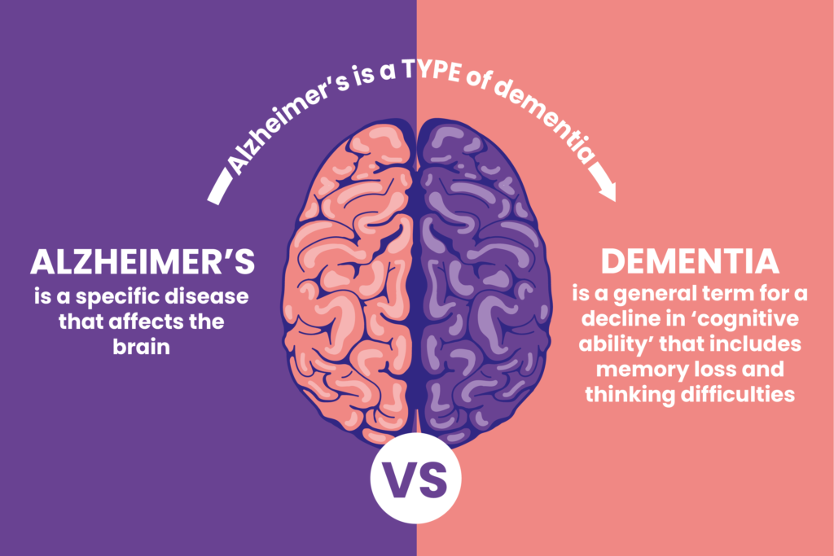
THEY ARE DIFFERENT

Slide 8
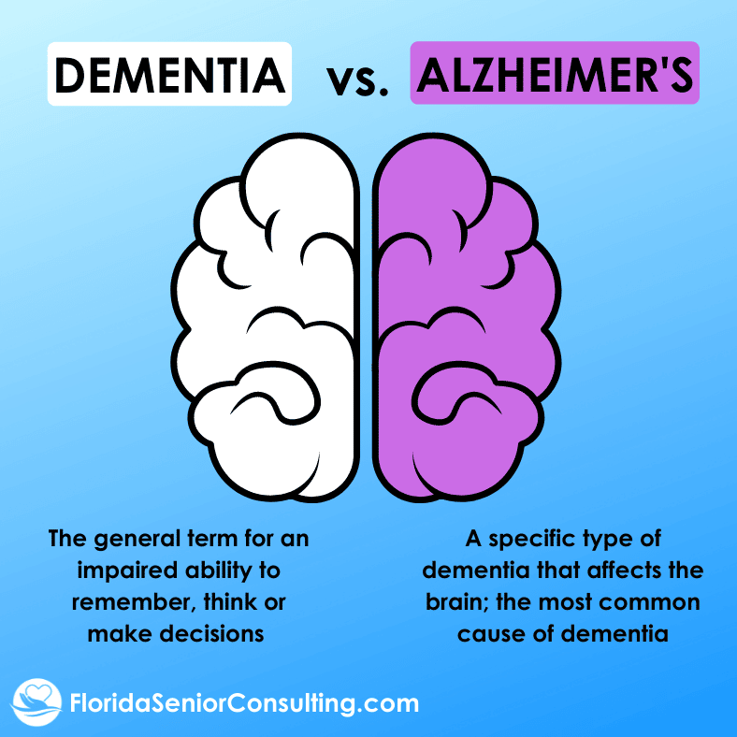
THEY ARE DIFFERENT
ALL MAY GET DEMENTIA
AGING IS NOT A DISEASE

Slide 10
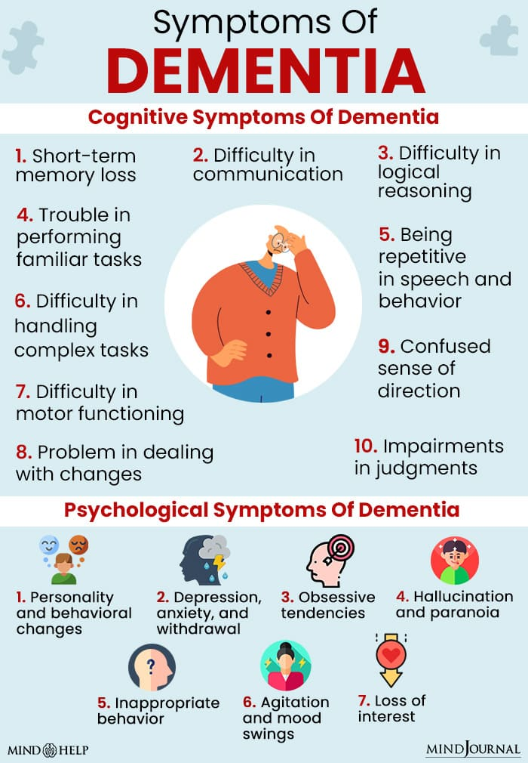
DEMENTIA
Psychological Symptoms
Depression

Slide 12
TYPES OF DEMENTIA

Slide 13
ALZHEIMER’S SYMPTOMS

Slide 16
COGNITION vs FUNCTION
Cognition – thinking (acquiring, processing and storing information)
Function – Action (ability to perform activities), ADL –bathing, dressing, grooming, feeding self,
Function – Independence- GI
Early stage: Cognitive issues more pronounced than functional issues

Slide 18
ALZHEIMER’S MEDICATION
Drugs that change disease progression-
Drugs that treat symptoms
Cognition- memory, orientation
Function- conducting personal financing, performing household chores

Slide 19
PREVENTION/LIMIT
MANAGE & IMPROVE BP-
ARTICLE- Saunero & Hughes, Alzheimer’s & Dementia Journal, vol. 20. issue 8, July 2024- systolic
ATTENDING CHURCH! -GOOD MENTAL HEALTH
Social Engagement
Physical Exercise
Mental Exercise – reading, class, hobby
Avoid Substances – smoking, drugs, alcohol

Slide 20
PROPER HOME BP MEASUREMENT
Daily Initially

Slide 22
BEST TECHNIQUE TO CHECK BP!
Don’t drink caffeine, smoke, or exercise at least 30 minutes before you take your blood pressure.
Empty your bladder before the test.
Sit with your back straight, such as a on a dining chair, with both feet on the floor.
Rest quietly for at least 5minutes before you take a reading.
Do not move, talk, or text while you take your blood pressure.
Check a second time standing if elevated.

Slide 23
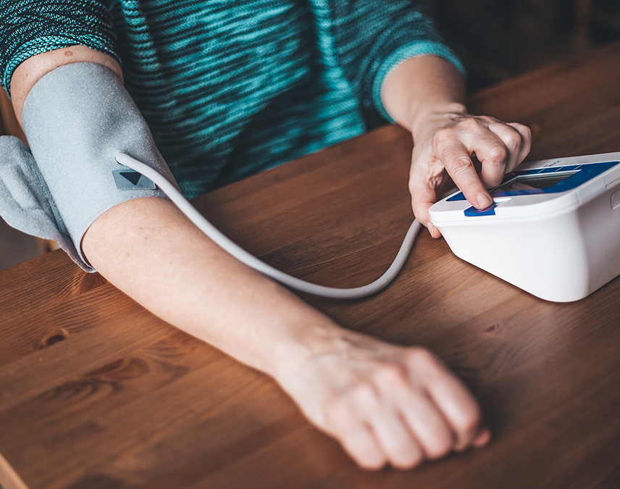
BETTER WAY!
No stethoscope needed
Self inflates
Saves, dates, times and stores BP/Pulse
Bring your BP unit to MD office to have it validated

Slide 24
Remember that managing blood pressure is crucial for overall health.
Regular check-ups
Lifestyle modifications
Adherence to prescribed medications can help control hypertension
Significant Genetic Component- Not always your fault!

Slide 25
TREATMENT OF PROBLEM
SILENT KILLER!
TOP 5 CAUSES
ALL ARE CONNECTED

Slide 26
TREATMENT
Variability = Complexity

Slide 27
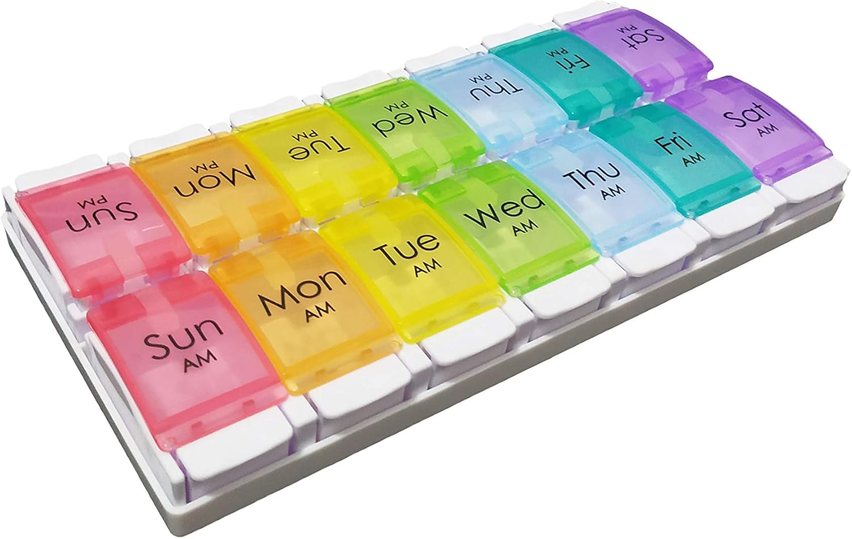
PILL BOX
PRACTICAL!
CONTROL
DECREASES CONFUSION
IMPROVES QUALITY HEALTHCARE
Gift

Slide 28
SUMMARY
Dementia is not a disease, but rather an umbrella term that describes a wide range of symptoms that affect people's ability to perform everyday activities on their own. Changes with age!
Alzheimer is a disease of the brain that is a severe type of dementia.
Alzheimer’s disease is the most common type of dementia.
Common symptoms of dementia include thinking issues-decrease memory, poor judgment, decrease focus, changes in language, changes in behavior.
PROPER BP CONTROL IMPROVES DEMENTIA!
Remember PILL BOX!
Show more compassion- family, others especially if > 65yrs.
Notes:
Google questions!

Slide 29
PODCAST: LEADERSHIP MASTERCLASS SERIES ADDED TO:
MINISTRY
EVENTS
CHURCH WEBSITE
www.stsbc.org
PODCAST WEBSITE
www.thwwp.com

Slide 30
“BE THE CHANGE YOU WANT TO SEE IN THE WORLD”

Slide 31
“LEADERSHIP MASTERCLASS”
IMPROVING BLOOD PRESSURE
MANAGEMENT CAN
DECREASE DEMENTIA!!
William T. Choctaw, MD, JD.
Podcast Host, www.thwwp.com
President, Choctaw Medical Group, Inc.,
Chief Transformation Officer, Emeritus, Citrus Valley Health Partners,
Former Hospital Surveyor, The Joint Commission
Notes:
Welcome to the healthy wealthy and wise podcast as a part of our leadership masterclass series, designed to help you to live long and thrive. We are delight to have you with us… I am Dr. W. Choctaw and I will be your facilitator this morning. … following info partly based on my >50ys surgical practice, executive healthcare leadership, hospital quality/safety national experience.
50 yrs experience MD, personal opinions follow up with own MD. Thinking outside the box, If you are listening you leader or quickly becoming one. Today we are talking about HealthCare disparities!

