Slide 1
“LEADERSHIP MASTERCLASS”
STROKE: PREVENTION,
TREATMENT, RECOVERY!
William T. Choctaw, MD, JD.
Podcast Host, www.thwwp.com
President, Choctaw Medical Group, Inc.,
Chief Transformation Officer, Emeritus, Citrus Valley Health Partners,
Former Hospital Surveyor, The Joint Commission
Notes:
Welcome to the healthy wealthy and wise podcast as a part of our leadership masterclass series, designed to help you to live long and thrive. We are delight to have you with us… I am Dr. W. Choctaw and I will be your facilitator this morning. … following info partly based on my >50ys surgical practice, executive healthcare leadership, hospital quality/safety national experience.
50 yrs experience MD, personal opinions follow up with own MD. Thinking outside the box, If you are listening you leader or quickly becoming one. Today we are talking about HealthCare disparities!

Slide 2
Beliefs
I believe life is about service to others.
I believe knowledge is power.
I believe leaders can change the world.
Notes:
My beliefs

Slide 3
MASTERCLASS MEDICINE
Inform/educate/motivate
EDUCATION NOT MEDICAL ADVICE

Slide 4
DEFINITION
A stroke is damage to the brain that occurs when a blood vessel in the brain bursts or gets blocked by a blood clot.
Without blood and the oxygen it carries, part of the brain starts to die.
The part of the body controlled by the damaged area of the brain can't work well.
Quick treatment can help limit the damage and increase the chance of a full recovery.

Slide 6
RISK FACTORS
Manage health problems that raise your risk. These include atrial fibrillation, diabetes, high blood pressure, and high cholesterol.
Have a heart-healthy lifestyle.
Don't smoke. If you need help quitting, talk to your doctor about stop-smoking programs and medicines. These can increase your chances of quitting for good.
Limit alcohol to 2 drinks a day for men and 1 drink a day for women.
Stay at a healthy weight. Lose weight if you need to.
Be active. Get at least 30 minutes of exercise on most days of the week. Walking is a good choice. You also may want to do other activities, such as running, swimming, cycling, or playing tennis or team sports.
Eat heart-healthy foods. These include vegetables, fruits, nuts, beans, lean meat, fish, and whole grains. Limit sodium and sugar.
If you think you may have a problem with alcohol or drug use, talk to your doctor.
If you use hormone therapy for menopause or hormonal birth control, talk with your doctor. Ask if these are right for you. They may raise the risk of stroke in some people.

Slide 7
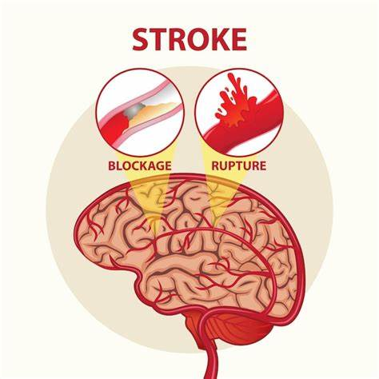
NEW CDC WARNINGS
- HIGHER 7.8% PREVALENCE <65YRS
INCREASED IN MINORITIES
5TH CAUSE OF DEATH
- LEADING CAUSE OF DISABILITY

Slide 8
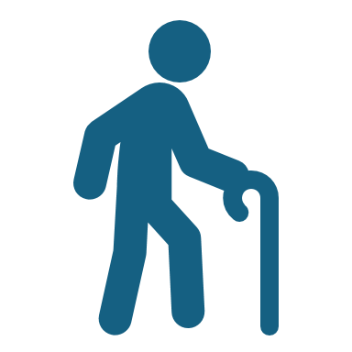
HIGHER STROKES IN YOUNGER PATIENTS!
CDC 2024!

Slide 10
PHYSICIAN/PATIENT RELATIONSHIP

Slide 11
TYPES OF STROKE

Slide 12
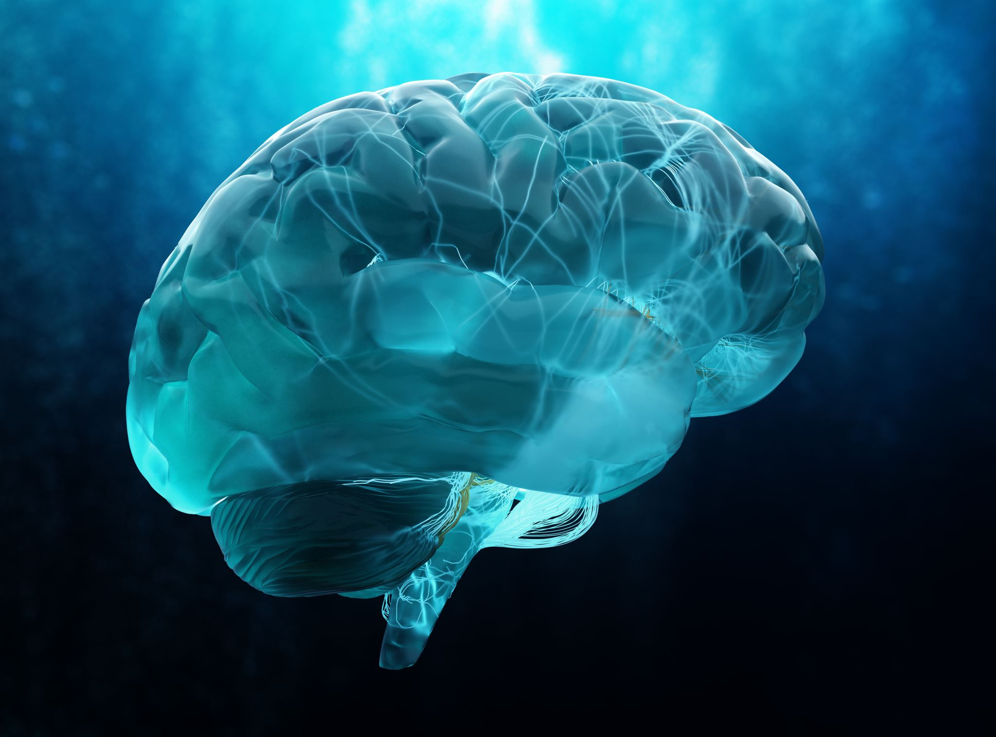
ISCHEMIC STROKE
For this type of stroke, treatment focuses on restoring blood flow to the brain.
You may get a clot-dissolving medicine called tissue plasminogen activator (TPA). This medicine can improve recovery from a stroke, especially if it's given as soon as possible after the stroke happens. Doctors try to give this medicine within 4½ hours after symptoms start.footnote1
You may also get aspirin or another antiplatelet medicine.
In some cases, a procedure may be done to restore blood flow. The doctor uses a thin, flexible tube (catheter) and a tool inside the tube to remove the blood clot that caused the stroke. This procedure is called a thrombectomy.
BLOOD NOT IN BLOOD VESSEL DOES NOT GET TO BRAIN CELLS!

Slide 13
BLEEDING STROKE
Hemorrhagic stroke.
For this type of stroke, treatment focuses on controlling bleeding, reducing pressure in the brain, and stabilizing vital signs, especially blood pressure.
To stop the bleeding, you may get medicine or a transfusion of parts of blood, such as plasma. These are given through an I.V.
You will be closely watched for signs of increased pressure on the brain.
If the bleeding is from a ruptured brain aneurysm, surgery or a procedure to repair the aneurysm may be done.
In some cases, medicines may be given to control blood pressure, brain swelling, blood sugar levels, fever, and seizures.
If a large amount of bleeding has occurred and symptoms are quickly getting worse, you may need surgery. The surgery can remove the blood that has built up inside the brain and lower pressure inside the head.
BLOOD NOT IN BLOOD VESSEL DOES NOT TO GET TO BRAIN!

Slide 14
Common signs of a stroke in women
Numbness or weakness in face, arm, or leg
Trouble speaking or understanding speech
Vision problems
Trouble walking, dizziness, or lack of balance or coordination
Severe headache with no other cause
Additional symptoms more common among females include nausea, vomiting, seizures, hiccups, trouble breathing, and sudden drowsiness¹.

Slide 15
COMMON SIGNS OF STROKE IN MEN
Sudden numbness or weakness in the face, arm, or leg, especially on one side of the body.
Confusion, trouble speaking, or difficulty understanding speech.
Trouble seeing in one or both eyes.
Trouble walking, dizziness, loss of balance, or lack of coordination.
Severe headache with no other cause.

Slide 16
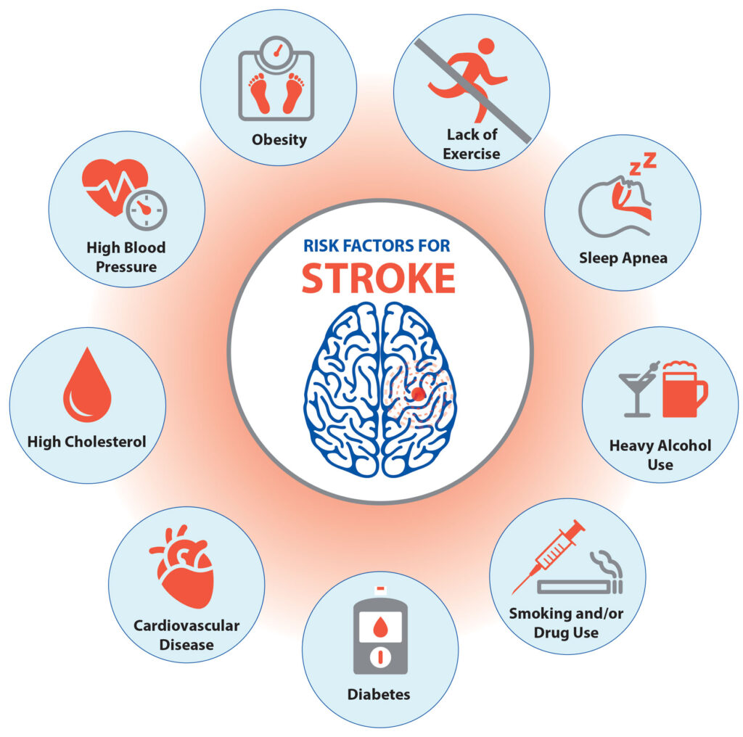
RISK FACTORS

Slide 17
CAUSES

Slide 20
YOU WANT HOSPITAL WITH A STROKE CENTER!

Slide 21
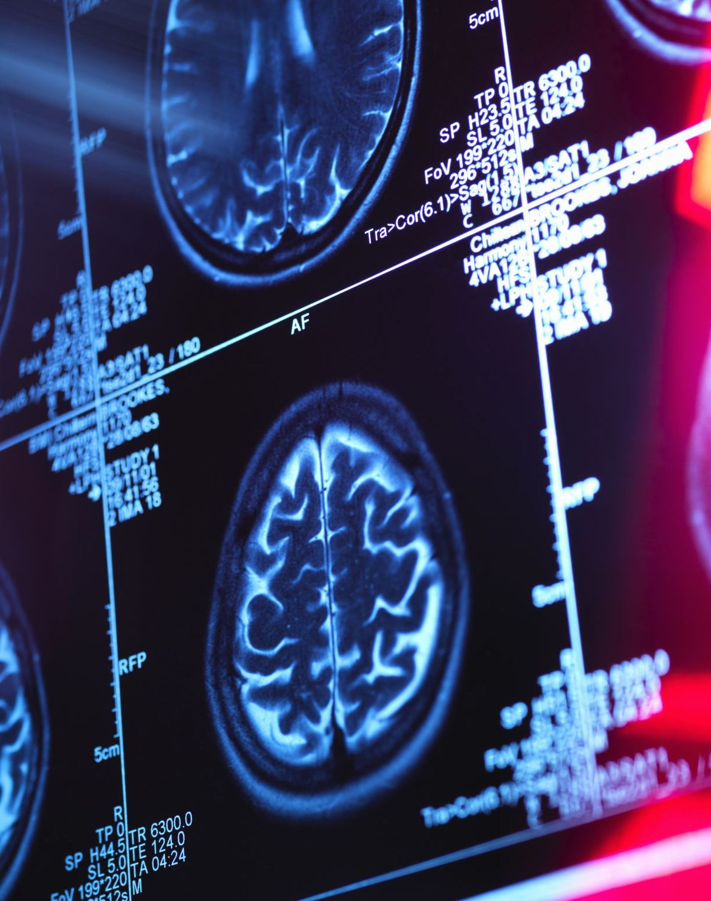
EMERGENCY TREATMENT OF STROKE
For this type of stroke, treatment focuses on controlling bleeding, reducing pressure in the brain, and stabilizing vital signs, especially blood pressure.
To stop the bleeding, you may get medicine or a transfusion of parts of blood, such as plasma. These are given through an I.V.
You will be closely watched for signs of increased pressure on the brain.
If the bleeding is from a ruptured brain aneurysm, surgery or a procedure to repair the aneurysm may be done.
In some cases, medicines may be given to control blood pressure, brain swelling, blood sugar levels, fever, and seizures.
If a large amount of bleeding has occurred and symptoms are quickly getting worse, you may need surgery. The surgery can remove the blood that has built up inside the brain and lower pressure inside the head.

Slide 22
THROMBECTOMY/HEMOSTASIS

Slide 23
PREVENTION
Stop Smoking
Eat Five Portions of Fruit Daily
Daily Increase Heart = EXERCISE!!

Slide 26
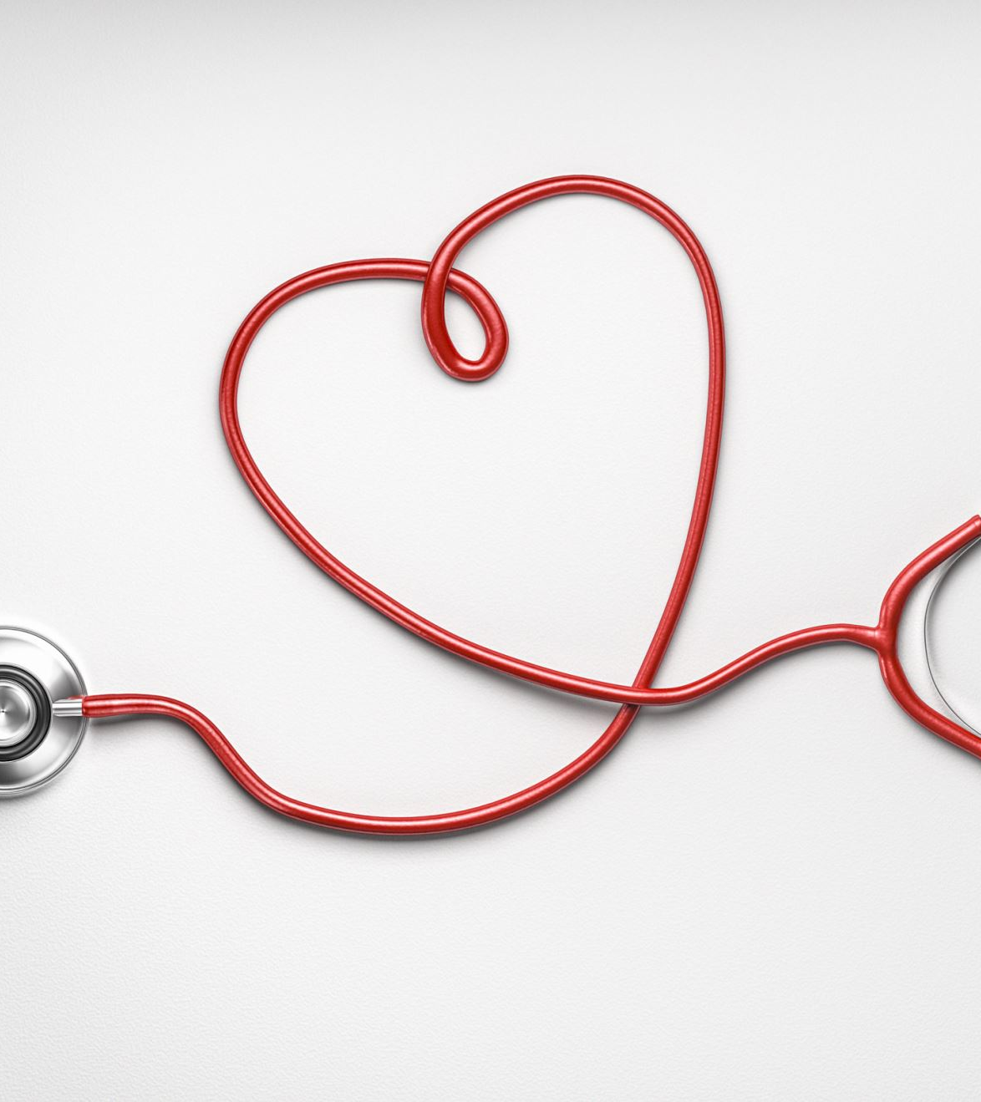
PREVENTION
Benefits for your heart
Being active helps keep your heart and blood vessels healthy in many ways. It can:
Raise "good" (HDL) cholesterol levels.
Help you lose weight or stay at a healthy weight.
Lower blood pressure.
Control blood sugar.

Slide 27
HEART HEALTHY LIFESTYLE
Don't smoke.
Limit alcohol to 2 drinks a day for men and 1 drink a day for women.
Stay at a healthy weight.
Be active. Ask your doctor what type and level of activity is safe for you.
Eat heart-healthy foods. These include vegetables, fruits, nuts, beans, lean meat, fish, and whole grains. Limit sodium and sugar.

Slide 29
PERSEVERANCE

Slide 30
SUMMARY
ISCHEMIC & HEMORRHAGIC STROKES
HEALTHY LIFESTYLE PREVENTS
GO TO THE HOSPITAL EMERGENCY ROOM
WITH A STROKE CENTER IF POSSIBLE
SURGERY IS POSSIBLE
GOOD REHABILITATION SIGNIFICANTLY IMPROVES RECOVERY!

Slide 31
My Basic Principles!
God is in charge!
No bad days
Don’t sweat the small stuff
Forgiveness is therapy
Everything is a relationship- mutual trust/mutual respect/good communication

Slide 32
PODCAST: LEADERSHIP MASTERCLASS SERIES ADDED TO:
MINISTRY
EVENTS
CHURCH WEBSITE
www.stsbc.org
PODCAST WEBSITE
www.thwwp.com

Slide 33
“BE THE CHANGE YOU WANT TO SEE IN THE WORLD”

Slide 34
“LEADERSHIP MASTERCLASS”
STROKE: PREVENTION,
TREATMENT, RECOVERY!
William T. Choctaw, MD, JD.
Podcast Host, www.thwwp.com
President, Choctaw Medical Group, Inc.,
Chief Transformation Officer, Emeritus, Citrus Valley Health Partners,
Former Hospital Surveyor, The Joint Commission
Notes:
Welcome to the healthy wealthy and wise podcast as a part of our leadership masterclass series, designed to help you to live long and thrive. We are delight to have you with us… I am Dr. W. Choctaw and I will be your facilitator this morning. … following info partly based on my >50ys surgical practice, executive healthcare leadership, hospital quality/safety national experience.
50 yrs experience MD, personal opinions follow up with own MD. Thinking outside the box, If you are listening you leader or quickly becoming one. Today we are talking about HealthCare disparities!

